Slide 1
Medical services in sexual abuse cases in India: Strengths and weaknesses Presented by Kushi Kushalappa ISPCAN 2018
Working for child safety and gender empowerment since 2001

Slide 2
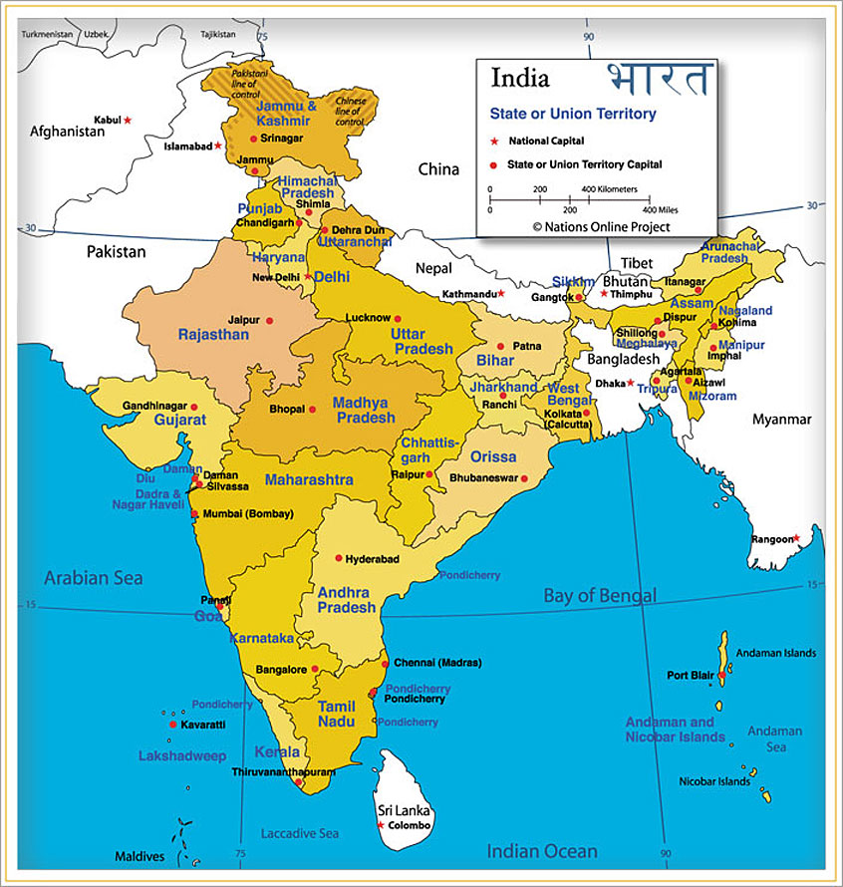
India facts
Population: 1400 million
Children: 440 million
Districts: 640
Official Languages: 14
Total languages and dialects spoken: 720
Doctors vs population:
1: 1,000
Notes:
*Trying to get figures that are accurate from reliable sources. Will put this in.

Slide 3
Change in laws
Before 2012
‘Rape’ or ’Sodomy’
Only peno-vaginal or peno-anal
Non penile assault not considered
Male perpetrator only
Heavily dependent on medical opinion
Comments on ‘intact hymen’
Absence of medical injuries considered that sexual assault has not occurred
After 2012
Any type of contact and noncontact sexual violence
Any person perpetrator
Medical exam shows no injuries
Medical exam is often to reassure the victim/family
Importance of psychological care
Importance of social support

Slide 4
Effective medical services
Therapeutic:
Trained doctors and nurses
Accessible
Medicolegal:
Forensic examination on first contact and complete
Ensuring dignity of the child
Sensitivity
Privacy and confidentiality
Multidisciplinary team work
Social awareness
Community awareness programs

Slide 5
Medical services and the law: 1/3
Protection of Children from Sexual Offences
(POCSO) Act 2012
Mandatory reporting of all sexual offences against children
Punishment for non reporting
Filing police report (FIR) mandatory
Setting up of Special Courts
Time bound trial and completion
Refusal by doctor to treat victim of sexual assault punishable with imprisonment of up to 1 year

Slide 6
Medical services and the law: 2/3
Medical guidelines (Ministry of Health and Family Welfare)
For consent (< 12 years/ > 12 years/ parents)
For treatment
For collecting forensic evidence
For writing a medical opinion
Criminal Procedure Code and Indian Penal Code
any registered medical practitioner to conduct med exam
All hospitals, government & private
Free emergency care to sexual assault victims
Copy of medical report to child/family

Slide 7
Medical services and the law: 3/3
Treatment of injuries
Screening for sexually transmitted diseases
HIV post exposure prophylaxis
Emergency contraception (post pubertal girls)
MTP Act
Right to health
If pregnancy is below 20 weeks gestation & child under 12 years, parents’ consent sufficient.
If pregnancy is between 12 to 20 weeks, medical opinion of 2 doctors sufficient for termination
If pregnancy beyond 20 weeks, permission required from High Court

Slide 8
Current situation
Existing medical infrastructure
Distance to quality medical care in rural India
Huge volume of cases at medical facilities
Coordination between responders like police, emergency medical services, child protection services
Lack of training on nature of samples to be collected based on history of abuse
Trials rely heavily on medical opinions and forensic reports; no medical evidence in most cases.

Slide 9
Challenges: personnel
Medical and nursing curriculum needs an upgrade
Training in forensic examination inadequate
On-going training in interviewing a child and history taking
In districts availability of staff 24/7

Slide 10
Challenges: infrastructure
Separate space for interview / examination
(emergency ward or labor room inappropriate but used due to lack of space)
Sexual assault examination material supply
Storage for forensic evidence and transport
( long distances to travel, dependent on police)
Forensic Science Laboratories are few

Slide 11
One stop centers
Initiative of Government of India (Ministry of Women and Child Development ) following Nirbhaya case in 2012
In every district across India (640 districts + 20 metropolis)
since 2013.
located within District government hospital
To respond to sexual crimes, domestic violence
Convergent model – multi-disciplinary response
(doctors, police, lawyers, counsellors, case workers)
Available round the clock
Survivor has access to medical /psycho-social/ legal services under one roof

Slide 12
Collaborative Child Response Units (CCRUs)
Concept by Enfold Trust in 2011
Rolled out in Karnataka State in coordination with ICPS, Department of Women and Child Development, supported by UNICEF
Hospital based, multi-disciplinary team approach
Single stop to address medical-psycho-social needs of children reporting sexual abuse
Convergence of stakeholders, sensitized, trained and informed response, reducing re-traumatization of child and family
Challenges: Scaling up the training and monitoring of the functioning of the CCRUs

Slide 13
Dilaasa center, Mumbai
Collaboration between Municipal Corporation of Mumbai and CEHAT
Hospital based crisis center, responding to domestic and sexual violence against women and children
First Center at Bhabha hospital, Mumbai in 2001
11 Units in and around Mumbai
Referrals received through health care system, community, Awareness (IEC) material, ex-clients
Providing counselling at the psycho-social and legal level and referring onto trained specialists.
Challenges: Has to be included in the budget for sustainability, lack of coordination between Departments

Slide 14
Way forward …
Awareness to all people in contact with children:
(parents and care givers, staff of educational and residential institutions, daycare facilities, hospitals, mental health professionals)
To be aware of dynamics and prevalence of CSA
To be able to detect signs and symptoms of CSA
To know how to respond to sexual violence and reporting mechanisms
Increase number of trained mental health professionals across the country
Mandatory personal safety, sexuality and life skills education for children of all ages and caregivers
Inclusion of child sexual abuse as a subject in medical, mental health and social work courses

Slide 15
Thank You Enfold Proactive Health Trust enfoldindia.org +91 99000 94251 Surakshith App: Information, stories on personal safety for children Bal Suraksha App: Information on answering children’s questions, and managing CSA Stri Suraksha App: On crimes against women, laws, intervention and healing techniques All Apps in 11 languages, free on android
Notes:
Available for free in 11 languages
On Google Play
Help your child learn
Personal Safety through
age appropriate stories
Participate in evolving a society
where children are safe.

